Slide 1


Resu‑Mate: Career Doc Generator
Hybrid NLP+SLM System
SELECTIVE TOPICS IN GENERATIVE AI
(CS6210)
Group Project - I
Team Name: Token Titans
Presenters: Avijit Datta(2511AI33)
Jadhav Praful Nayak(2511CS03)
Kedharnath Reddy(2511AI36)

Slide 2
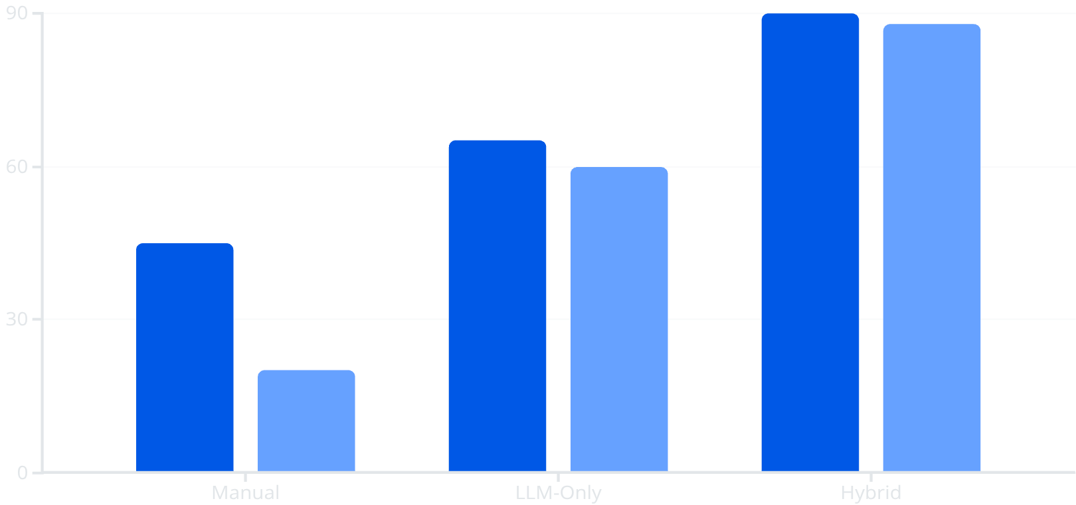
The Problem: Why Manual Applications Fall Short
Time-Consuming Customisation
Tailoring each resume and cover letter manually takes hours — and most applications still feel generic.
Precision vs. Context Gap
Pure keyword matching misses semantics. Pure LLMs risk hallucination. Neither alone is sufficient.
No Explainability
Accuracy Score
Efficiency Score
Existing tools provide no transparency into how well a resume actually aligns with a job description.
The hybrid approach delivers superior accuracy and efficiency over manual or LLM-only methods.

Slide 3
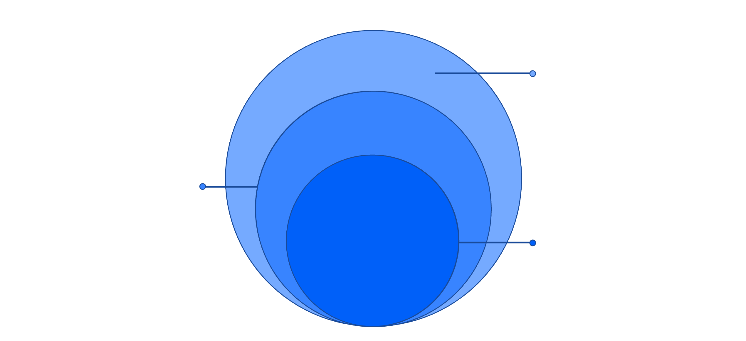
SYSTEM ARCHITECTURE
Three-Layer Architecture
External Systems
Ollama localhost:11434, llama3.2/phi3, nomic embeddings
Application Services
config, doc_processing, semantic_matching, llm service
Presentation
Streamlit UI, uploads, JD input, score display
A clean separation of concerns: the Presentation Layer captures user input via Streamlit; the Application Services Layer handles all NLP and LLM logic through modular Python services; the External Systems Layer interfaces with a locally hosted Ollama server for inference and embeddings.

Slide 4

CORE INNOVATION
Hybrid NLP + SLM Pipeline
Document Processing
SLM Refinement
Semantic Matching
Cosine Similarity Formula
Why This Matters
By filtering only the most relevant resume sections before passing them to the SLM, Resu-Mate dramatically reduces hallucination risk and keeps prompts focused, fast, and contextually precise.
Vectors A and B represent TF-IDF or embedding representations of resume sections and the job description.

Slide 5
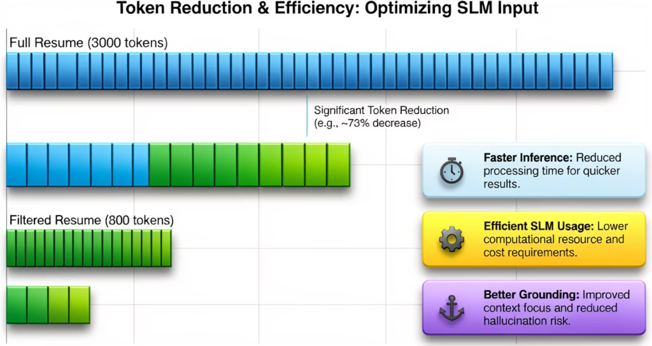
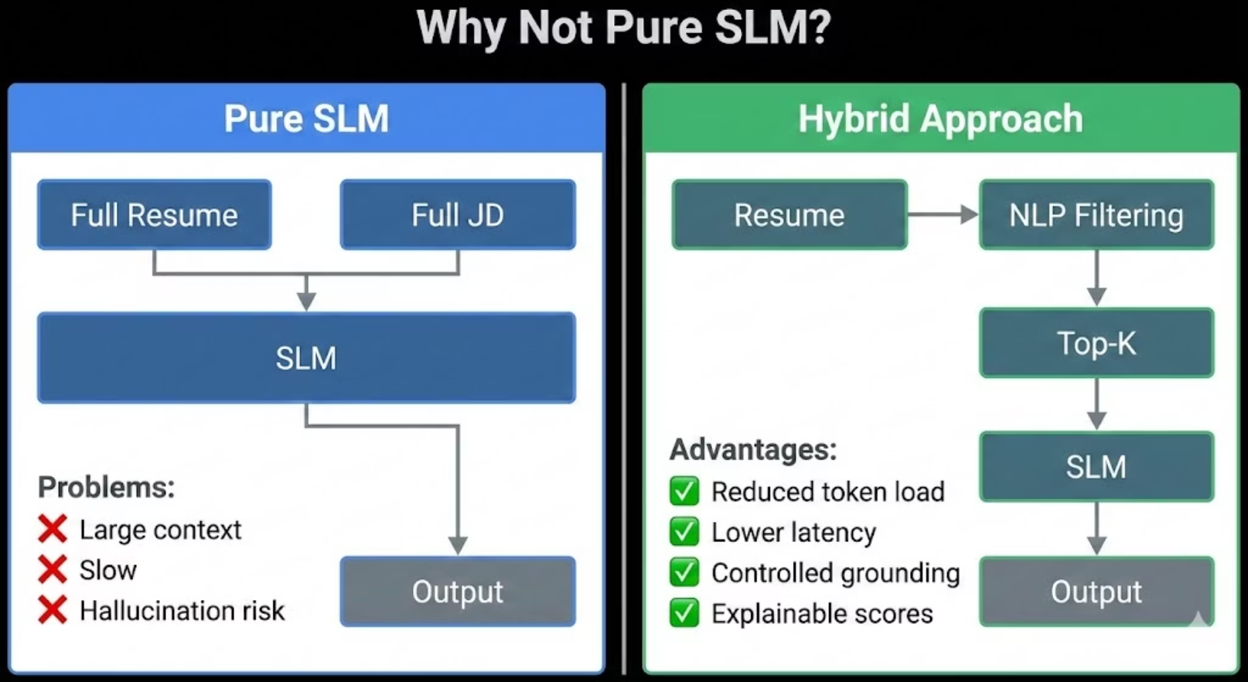

Slide 6








Results, Use Cases & Future Scope
Observed Results
Future Roadmap
Multi-language Support
Extend NLP pipeline to non-English CVs and JDs
Focused Output
Reduced Hallucination
Cloud Deployment
More targeted cover letters with direct job alignment
Pre-filtering keeps LLM grounded in real resume content
Containerised deployment on AWS / GCP with API access
ATS Compatibility Scoring
Predict Applicant Tracking System pass-through rates
RAG Integration
Explainability
Retrieval-Augmented Generation for richer, grounded output
Cosine scores reveal exactly why sections were selected
Use Cases
Job Seekers
Students
Career Coaches
Recruiters

Slide 7

Thank You
We hope you've enjoyed learning about Resu‑Mate.
We appreciate your time and attention.
Team Token Titans
Avijit Datta (2511AI33)
Jadhav Praful Nayak (2511CS03)
Kedharnath Reddy (2511AI36)
Any questions?

